Slide 1


Slide 2


Slide 3

Scenario I
VERSION 1
--------------------------
----------------
--------------------

Slide 4

Scenario I
VERSION 1
--------------------------
----------------
--------------------

Slide 5
Scenario I
VERSION 1
VERSION 2
--------------------------
----------------
--------------------
--------------------
-------------------
------------
----------------
-----------------------------------------------------------
--------------------------
----------------
--------------------

Slide 6
Scenario I
VERSION 1
VERSION 2
--------------------------
----------------
--------------------
--------------------
-------------------
------------
----------------
-----------------------------------------------------------
--------------------------
----------------
--------------------

Slide 7
Scenario I
VERSION 1
VERSION 2
VERSION 3
--------------------------
----------------
--------------------
--------------------
-------------------
------------
----------------
-----------------------------------------------------------
--------------------------
----------------
--------------------
--------------------
-------------------
------------------
------------
--------------------
----------------
--------------------
-------------------------------------------------------------------------------
--------------------------
----------------
--------------------

Slide 8

Scenario I
VERSION 1
VERSION 2
VERSION 3
--------------------------
----------------
--------------------
--------------------
-------------------
------------
----------------
-----------------------------------------------------------
--------------------------
----------------
--------------------
--------------------
-------------------
------------------
------------
--------------------
----------------
--------------------
-------------------------------------------------------------------------------
--------------------------
----------------
--------------------

Slide 9

Scenario I
VERSION 1
VERSION 2
VERSION 3
--------------------------
----------------
--------------------
--------------------
-------------------
------------
----------------
-----------------------------------------------------------
--------------------------
----------------
--------------------
--------------------
-------------------
------------------
------------
--------------------
----------------
--------------------
-------------------------------------------------------------------------------
--------------------------
----------------
--------------------

Slide 10

Scenario II
Features 1
--------------------------
----------------
--------------------

Slide 11
Scenario II
Features 1
Features 2
--------------------------
----------------
--------------------
--------------------------
----------------
--------------------

Slide 12
Scenario II
Features 1
Features 2
--------------------------
----------------
--------------------
--------------------------
----------------
--------------------
Features 3
--------------------------
----------------
--------------------

Slide 13
Scenario II
Features 1
Features 2
--------------------------
----------------
--------------------
--------------------------
----------------
--------------------
Features 3
Features 4
--------------------------
----------------
--------------------
--------------------------
----------------
--------------------

Slide 14
Scenario II
Features 1
Features 2
--------------------------
----------------
--------------------
--------------------------
----------------
--------------------
COMBINED
Features 3
Features 4
--------------------------
----------------
--------------------
--------------------------
----------------
--------------------

Slide 15
Scenario II
Features 1
Features 2
--------------------------
----------------
--------------------
--------------------------
----------------
--------------------
COMBINED
Features 3
Features 4
Merging Features
--------------------------
----------------
--------------------
--------------------------
----------------
--------------------

Slide 16





Scenario III
UK
Bangladesh
USA

Slide 17
Scenario III
UK
Bangladesh
USA

Slide 18
Scenario III
UK
Bangladesh
USA

Slide 19
Scenario III
UK
Bangladesh
USA

Slide 20
Scenario III
UK
Bangladesh
USA

Slide 21
Scenario III
UK
Bangladesh
USA

Slide 22
Scenario III
UK
Bangladesh
USA

Slide 23
Scenario III
UK
Bangladesh
Team collaboration
USA

Slide 24


Version Tracking
Version Control System
Changes Tracking
Merging Features
Team collaboration
.
.
.
.
.
.
Store all the records in cloud

Slide 25


Service
Tools/ software/ system
Host git repository/ folder/ source code
Change control/ version control.....
Provides GUI interface
Provides CLI (Command Line interface Tools)
Maintained on cloud / web
Installed and maintained locally

Slide 26

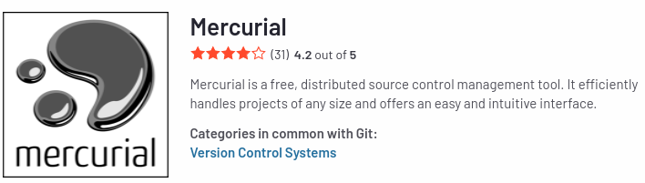
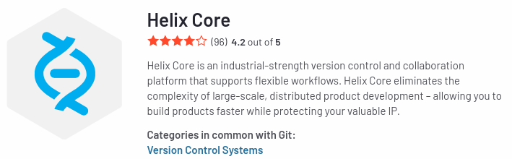
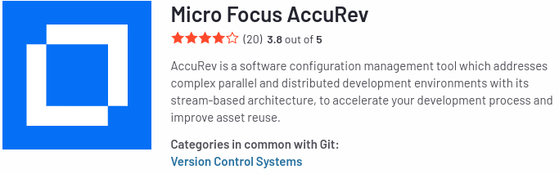

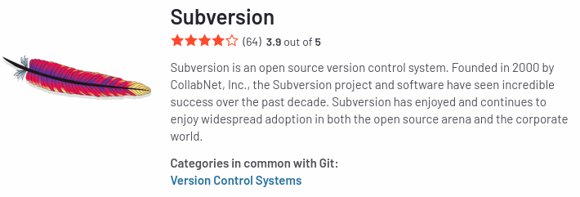
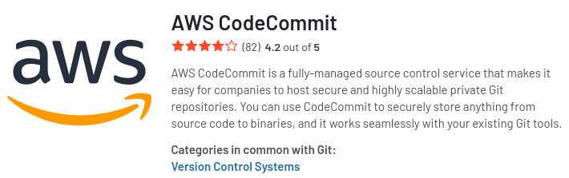
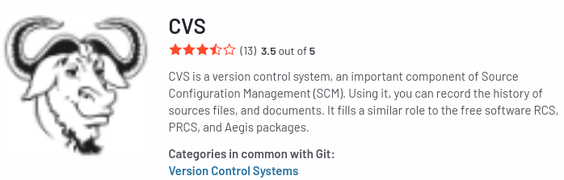

List of Version Control System

Slide 27

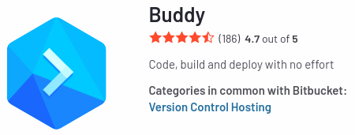
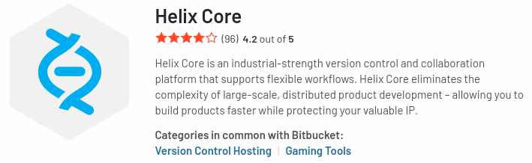

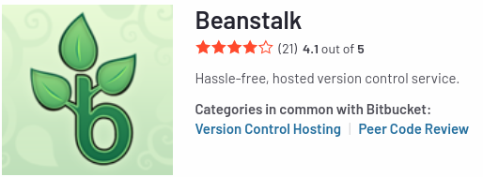

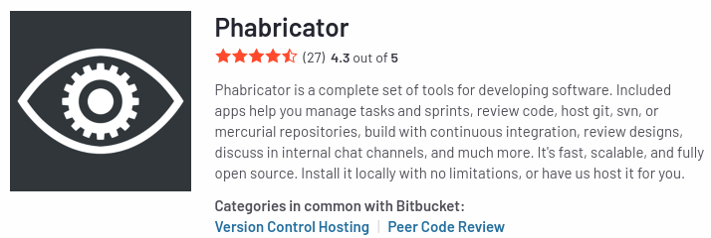
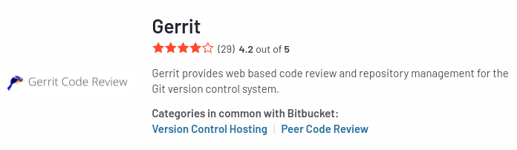

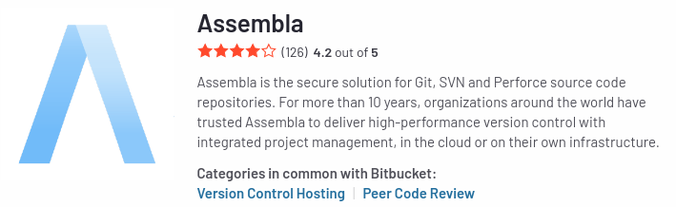

List of Version Control System Host
https://www.g2.com/products/bitbucket/competitors/alternatives

Slide 28
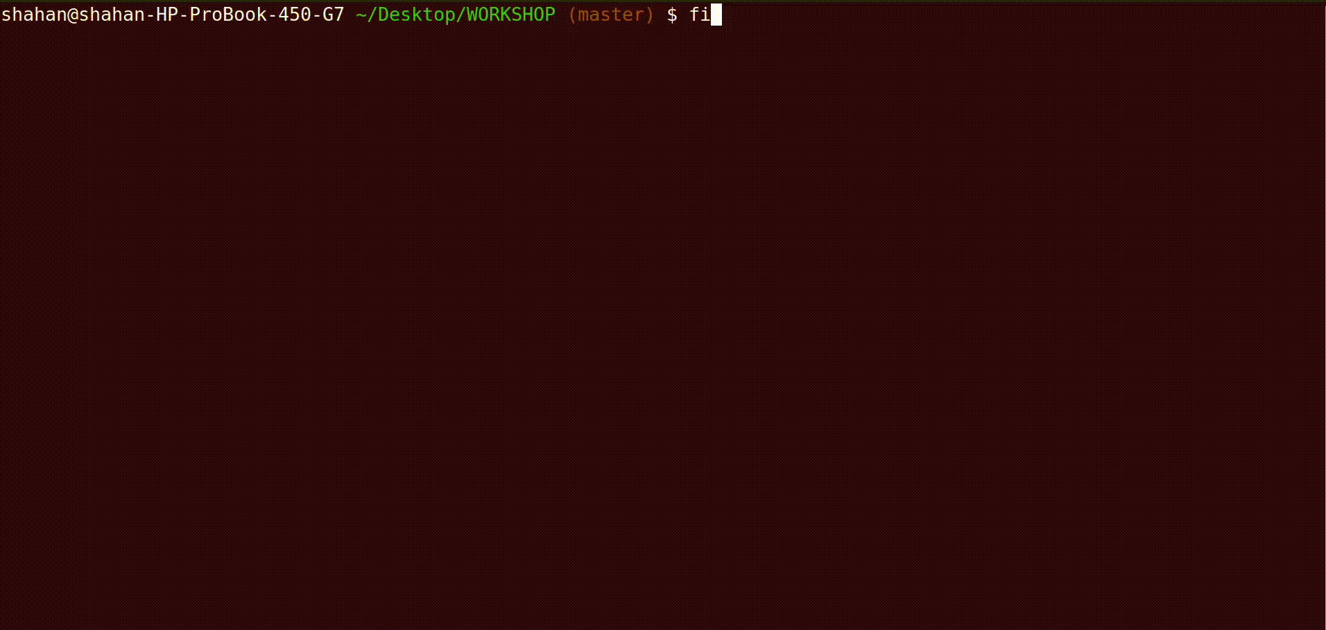

Slide 29
Create A folder

Slide 30
Create A folder
Initialize Git

Slide 31
Create A folder
Create A git repo
Initialize Git

Slide 32
Create A folder
Create A git repo
Initialize Git
Clone the repository

Slide 33
Create A folder
Create A git repo
Working Directory
Initialize Git
Clone the repository

Slide 34
Create A folder
Create A git repo
Working Directory
Initialize Git
Clone the repository
Check the status

Slide 35
Create A folder
Create A git repo
Working Directory
Initialize Git
Clone the repository
Check the status
WORKSHOP

Slide 36
Create A folder
Create A git repo
Working Directory
Initialize Git
Clone the repository
Check the status
WORKSHOP
Demo.c
Demo.c
Sakdsajdasd
Sadasdsad
sadsadsd

Slide 37
Create A folder
Create A git repo
Working Directory
Initialize Git
Clone the repository
Check the status
Unstage
WORKSHOP
Demo.c
Demo.c
Sakdsajdasd
Sadasdsad
sadsadsd

Slide 38
Create A folder
Create A git repo
Working Directory
Initialize Git
Clone the repository
Check the status
Unstage
WORKSHOP
Demo.c
Git add
Demo.c
Sakdsajdasd
Sadasdsad
sadsadsd

Slide 39
Create A folder
Create A git repo
Working Directory
Initialize Git
Clone the repository
Check the status
Unstage
WORKSHOP
Demo.c
Git add
Demo.c
Demo.c
Sakdsajdasd
Sadasdsad
sadsadsd
Demo.c
Sakdsajdasd
Sadasdsad
sadsadsd

Slide 40
Create A folder
Create A git repo
Working Directory
Initialize Git
Clone the repository
Check the status
Unstage
staging
WORKSHOP
Demo.c
Git add
Demo.c
Demo.c
Sakdsajdasd
Sadasdsad
sadsadsd
Demo.c
Sakdsajdasd
Sadasdsad
sadsadsd

Slide 41
Create A folder
Create A git repo
Working Directory
Initialize Git
Clone the repository
Check the status
Unstage
staging
WORKSHOP
Demo.c
Git add
Demo.c
Git rm --cached
Demo.c
Sakdsajdasd
Sadasdsad
sadsadsd
Demo.c
Sakdsajdasd
Sadasdsad
sadsadsd

Slide 42
Create A folder
Create A git repo
Working Directory
Initialize Git
Clone the repository
Check the status
Unstage
staging
WORKSHOP
Demo.c
Git add
Demo.c
unstaging
Git rm --cached
Demo.c
Sakdsajdasd
Sadasdsad
sadsadsd
Demo.c
Sakdsajdasd
Sadasdsad
sadsadsd

Slide 43
Create A folder
Create A git repo
Working Directory
Initialize Git
Clone the repository
Check the status
Unstage
staging
WORKSHOP
Demo.c
Git add
Demo.c
unstaging
Git rm --cached
Git add
Demo.c
Sakdsajdasd
Sadasdsad
sadsadsd
Demo.c
Sakdsajdasd
Sadasdsad
sadsadsd
Staging

Slide 44
Create A folder
Create A git repo
Working Directory
Working Directory
Initialize Git
Clone the repository
WORKSHOP
Check the status
Unstage
staging
WORKSHOP
Demo.c
Git add
Demo.c
unstaging
Git rm --cached
Git add
Demo.c
Sakdsajdasd
Sadasdsad
sadsadsd
Demo.c
Sakdsajdasd
Sadasdsad
sadsadsd
Staging

Slide 45
Create A folder
Create A git repo
Working Directory
Working Directory
Initialize Git
Clone the repository
WORKSHOP
Folder is Untracked
Check the status
Unstage
staging
WORKSHOP
Demo.c
Git add
Demo.c
unstaging
Git rm --cached
Git add
Demo.c
Sakdsajdasd
Sadasdsad
sadsadsd
Demo.c
Sakdsajdasd
Sadasdsad
sadsadsd
Staging

Slide 46
Create A folder
Create A git repo
Working Directory
Working Directory
Initialize Git
Clone the repository
WORKSHOP
git init
Check the status
Unstage
staging
WORKSHOP
Demo.c
Git add
Demo.c
unstaging
Git rm --cached
Git add
Demo.c
Sakdsajdasd
Sadasdsad
sadsadsd
Demo.c
Sakdsajdasd
Sadasdsad
sadsadsd
Staging

Slide 47
Create A folder
Create A git repo
Working Directory
Working Directory
Initialize Git
Clone the repository
WORKSHOP
Folder is tracked
Check the status
Unstage
staging
WORKSHOP
Demo.c
Git add
Demo.c
unstaging
Git rm --cached
Git add
Demo.c
Sakdsajdasd
Sadasdsad
sadsadsd
Demo.c
Sakdsajdasd
Sadasdsad
sadsadsd
Staging

Slide 48
Create A folder
Create A git repo
Working Directory
Working Directory
Initialize Git
Clone the repository
WORKSHOP
Demo.c
Folder is tracked
Check the status
Unstage
staging
WORKSHOP
Demo.c
Git add
Demo.c
unstaging
Git rm --cached
Git add
Demo.c
Sakdsajdasd
Sadasdsad
sadsadsd
Demo.c
Sakdsajdasd
Sadasdsad
sadsadsd
Staging

Slide 49
Create A folder
Create A git repo
Working Directory
Working Directory
Initialize Git
Clone the repository
WORKSHOP
Demo.c
Folder is tracked
Check the status
Inside the file there is no tracking
Unstage
staging
WORKSHOP
Demo.c
Git add
Demo.c
unstaging
Git rm --cached
Git add
Demo.c
Sakdsajdasd
Sadasdsad
sadsadsd
Demo.c
Sakdsajdasd
Sadasdsad
sadsadsd
Staging

Slide 50
Create A folder
Create A git repo
Working Directory
Working Directory
Initialize Git
Clone the repository
WORKSHOP
Demo.c
Folder is tracked
!! Caution
Inside the file is Not tracking but Inside the folder is Tracking
Check the status
Inside the file there is no tracking
Unstage
staging
WORKSHOP
Demo.c
Git add
Demo.c
unstaging
Git rm --cached
Git add
Demo.c
Sakdsajdasd
Sadasdsad
sadsadsd
Demo.c
Sakdsajdasd
Sadasdsad
sadsadsd
Staging

Slide 51
Create A folder
Create A git repo
Working Directory
Working Directory
Initialize Git
Clone the repository
WORKSHOP
Demo.c
Folder is tracked
Git add
Check the status
Inside the file there is no tracking
Unstage
staging
WORKSHOP
Demo.c
Git add
Demo.c
unstaging
Git rm --cached
Git add
Demo.c
Sakdsajdasd
Sadasdsad
sadsadsd
Demo.c
Sakdsajdasd
Sadasdsad
sadsadsd
Staging

Slide 52
Create A folder
Create A git repo
Working Directory
Working Directory
Staging area/ index
Initialize Git
Clone the repository
WORKSHOP
Demo.c
Folder is tracked
Git add
Check the status
Inside the file there is no tracking
Demo.c
Unstage
staging
WORKSHOP
Demo.c
Git add
Demo.c
unstaging
Git rm --cached
Git add
Demo.c
Sakdsajdasd
Sadasdsad
sadsadsd
Demo.c
Sakdsajdasd
Sadasdsad
sadsadsd
Staging

Slide 53
Create A folder
Create A git repo
Working Directory
Working Directory
Staging area/ index
Initialize Git
Clone the repository
WORKSHOP
Demo.c
Folder is tracked
Git add
Check the status
Inside the file there is no tracking
Demo.c
Unstage
staging
WORKSHOP
Inside teh File is Tracking
Demo.c
Git add
Demo.c
unstaging
Git rm --cached
Git add
Demo.c
Sakdsajdasd
Sadasdsad
sadsadsd
Demo.c
Sakdsajdasd
Sadasdsad
sadsadsd
Staging

Slide 54
Create A folder
Create A git repo
Working Directory
Working Directory
Staging area/ index
Initialize Git
Clone the repository
WORKSHOP
Demo.c
Folder is tracked
Git add
Check the status
Inside the file there is no tracking
Git rm --cached
Demo.c
Unstage
staging
WORKSHOP
Demo.c
Git add
Demo.c
unstaging
Git rm --cached
Git add
Demo.c
Sakdsajdasd
Sadasdsad
sadsadsd
Demo.c
Sakdsajdasd
Sadasdsad
sadsadsd
Staging

Slide 55
Create A folder
Create A git repo
Working Directory
Working Directory
Staging area/ index
Initialize Git
Clone the repository
WORKSHOP
Demo.c
Folder is tracked
Git add
Check the status
Inside the file there is no tracking
Git rm --cached
Demo.c
Unstage
staging
WORKSHOP
Restore the changes
Git restore
Demo.c
Git add
Demo.c
unstaging
Git rm --cached
Git add
Demo.c
Sakdsajdasd
Sadasdsad
sadsadsd
Demo.c
Sakdsajdasd
Sadasdsad
sadsadsd
Staging

Slide 56
Recap with me

Slide 57
Working Directory
WORKSHOP
Initially: Folder is Not tracked

Slide 58
Working Directory
WORKSHOP
Git init

Slide 59
Working Directory
WORKSHOP
Folder is tracked

Slide 60
Working Directory
WORKSHOP
Folder is tracked
If you Clone a GitHub Repo, it will automatically tracked, means it’s by default initializeed git

Slide 61
Working Directory
WORKSHOP
Folder is tracked
Demo.c

Slide 62
Working Directory
WORKSHOP
Folder is tracked
Demo.c
Inside the file, are not Tracked

Slide 63
Working Directory
WORKSHOP
Folder is tracked
Demo.c
Git add
Inside the file, are not Tracked

Slide 64
Working Directory
Staging area/ index
WORKSHOP
Folder is tracked
Demo.c
Git add
Demo.c
Inside the file, are not Tracked

Slide 65
Added filed will be tracked
Working Directory
Staging area/ index
WORKSHOP
Folder is tracked
Demo.c
Git add
Demo.c
Inside the file, are not Tracked

Slide 66
Added filed will be tracked
Working Directory
Staging area/ index
WORKSHOP
Folder is tracked
Demo.c
Git add
Demo.c
Inside the file, are not Tracked
Git rm --cached

Slide 67
Added filed will be tracked
Working Directory
Staging area/ index
WORKSHOP
Folder is tracked
Demo.c
Git add
Demo.c
Inside the file, are not Tracked
Git rm --cached
See The Differecnes

Slide 68
Added filed will be tracked
Working Directory
Staging area/ index
WORKSHOP
Folder is tracked
Demo.c
Git add
Demo.c
Inside the file, are not Tracked
Git rm --cached
See The Differecnes
Git diff

Slide 69
Added filed will be tracked
Working Directory
Staging area/ index
WORKSHOP
Folder is tracked
Demo.c
Git add
Demo.c
Inside the file, are not Tracked
Git rm --cached
See The Differecnes
Git diff
Restore the changes

Slide 70
Added filed will be tracked
Working Directory
Staging area/ index
WORKSHOP
Folder is tracked
Demo.c
Git add
Demo.c
Inside the file, are not Tracked
Git rm --cached
See The Differecnes
Git diff
Restore the changes
Git restore

Slide 71
Added filed will be tracked
Working Directory
Staging area/ index
WORKSHOP
Folder is tracked
Demo.c
End of Local Repository
Git add
Demo.c
Inside the file, are not Tracked
Git rm --cached
See The Differecnes
Git diff
Restore the changes
Git restore

Slide 72
Added filed will be tracked
Working Directory
Staging area/ index
WORKSHOP
Folder is tracked
Demo.c
End of Local Repository
Git add
Demo.c
Inside the file, are not Tracked
Git rm --cached
See The Differecnes
Git diff
Restore the changes
Git restore

Slide 73

Added filed will be tracked
Working Directory
Staging area/ index
WORKSHOP
Folder is tracked
Demo.c
Git add
Demo.c
Inside the file, are not Tracked
Git rm --cached
See The Differecnes
Git diff
Restore the changes
Git restore

Slide 74
Added filed will be tracked
Working Directory
Staging area/ index
WORKSHOP
Folder is tracked
Demo.c
Git add
Demo.c
Inside the file, are not Tracked
Git rm --cached
See The Differecnes
Git diff
Restore the changes
Git commit
Git restore

Slide 75
Added filed will be tracked
Working Directory
Staging area/ index
WORKSHOP
Local Repository
Folder is tracked
Demo.c
Git add
Demo.c
Inside the file, are not Tracked
Git rm --cached
See The Differecnes
Git diff
Restore the changes
Git commit
Git restore

Slide 76
Added filed will be tracked
Working Directory
Staging area/ index
WORKSHOP
Local Repository
Folder is tracked
Demo.c
Git add
Demo.c
commit message
Message should be clear and understandable
Inside the file, are not Tracked
Git rm --cached
See The Differecnes
Git diff
Restore the changes
Git commit
Git restore
Git log

Slide 77
Added filed will be tracked
Working Directory
Staging area/ index
WORKSHOP
Local Repository
Folder is tracked
Demo.c
Git add
Demo.c
Inside the file, are not Tracked
Git rm --cached
See The Differecnes
Git diff
Restore the changes
Git commit
Git restore
Git log
git reset --soft HEAD^

Slide 78
Added filed will be tracked
Working Directory
Staging area/ index
WORKSHOP
Local Repository
Folder is tracked
Demo.c
Git add
Demo.c
Inside the file, are not Tracked
Git rm --cached
See The Differecnes
Git diff
Restore the changes
Git commit
Git restore
Git log
git reset --soft HEAD^
git reset --hard HEAD^

Slide 79
Added filed will be tracked
Working Directory
Staging area/ index
WORKSHOP
Local Repository
Folder is tracked
Demo.c
Git add
Demo.c
Inside the file, are not Tracked
Git rm --cached
Git push
See The Differecnes
Git diff
Restore the changes
Git commit
Git restore
Git log
git reset --soft HEAD^
git reset --hard HEAD^

Slide 80
Added filed will be tracked
Working Directory
Staging area/ index
WORKSHOP
Local Repository
Remote Repository
Folder is tracked
Demo.c
Git add
Demo.c
Inside the file, are not Tracked
Git rm --cached
Git push
See The Differecnes
Git diff
Restore the changes
Git commit
Git restore
Git log
git reset --soft HEAD^
git reset --hard HEAD^

Slide 81
Added filed will be tracked
Working Directory
Staging area/ index
WORKSHOP
Local Repository
Remote Repository
Folder is tracked
Demo.c
Git add
Demo.c
Inside the file, are not Tracked
Git rm --cached
Git push
See The Differecnes
Git diff
Restore the changes
Git commit
Git restore
Git log
git reset --soft HEAD^
git reset --hard HEAD^

Slide 82
Added filed will be tracked
Working Directory
Staging area/ index
WORKSHOP
Local Repository
Remote Repository
Folder is tracked
Demo.c
Git add
Demo.c
Inside the file, are not Tracked
Git rm --cached
Git push
See The Differecnes
Git diff
Restore the changes
Git commit
Git restore
Git log
git reset --soft HEAD^
git reset --hard HEAD^

Slide 83
Master Branch
#include <stdio.h>
int main()
{
int a, b, sum, sub, mult, div, rem;
scanf("%d",&a);
scanf("%d",&b);
sum=a+b;
sub=a-b;
mult=a*b;
div=a/b;
rem=a%b;
printf("%d\n",sum);
printf("%d\n",sub);
printf("%d\n",mult);
printf("%d\n",div);
printf("%d\n",rem);
}
Debug Branch
#include <stdio.h>
int main()
{
int a, b, sum, sub, mult, div, rem;
scanf("%d",&a);
scanf("%d",&b);
sum=a+b;
sub=a-b;
mult=a*b;
printf("%d\n",sum);
printf("%d\n",sub);
printf("%d\n",mult);
if (b==0)
{
printf("Denominator (b) cannot be zero");
}
else
{
div=a/b;
rem=a%b;
printf("%d\n",div);
printf("%d\n",rem);
}
}
Prompt Branch
#include <stdio.h>
int main()
{
int a, b, sum, sub, mult, div, rem;
printf("Enter number 1: ");
scanf("%d",&a);
printf("Enter number 2: ");
scanf("%d",&b);
sum=a+b;
sub=a-b;
mult=a*b;
div=a/b;
rem=a%b;
printf("Sum = %d\n",sum);
printf("Sub = %d\n",sub);
printf("Mult = %d\n",mult);
printf("Div = %d\n",div);
printf("Remainder = %d\n",rem);
}
Merge

